Slide 1
Using LLMs for Page Similarity Detection in PDFs
Emily Adams, Tony Xu, and Andrew Zhao

Slide 2
Problem Space
Laws are often broad-reaching documents with multiple jurisdictions
Lots of new laws in this space as countries pass Cybercrime laws in adherence with the Budapest Convention
Researchers interested in specific legal topics will read through an enormous amount of irrelevant information in the process of getting good data
Ensuring adherence with Leiden guidelines requires mapping entire current legal landscape, which is time-consuming and difficult
Prosecuting international issue runs into a lot of jurisdictional issues, difficult to have a picture of the relevant laws in all relevant jurisdictions

Slide 3
The Challenge with Large Documents
PDF documents can be lengthy and complex (e.g., legal, technical, or research papers), especially given max tokens
Need for automated relevance detection with semantic understanding.
Laws specifically are also formatted in a wide variety of ways across different countries

Slide 4
Automated Page Relevance Detection with LLMs
Extract text from each page of the PDF.
Use LLM embeddings to compute semantic similarity with provided keywords.
Rank pages by relevance for efficient analysis.

Slide 5
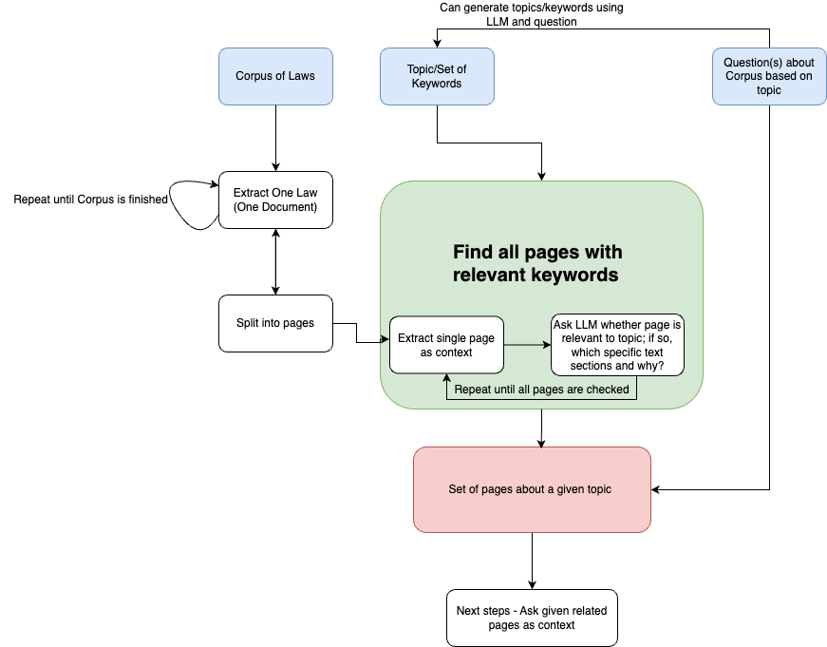

Slide 6
Demo Setup
Input:
A PDF of a legal document from our legal corpus
e.g., "(Bhutan 2005) Evidence Act ENG.pdf”
Keywords: "digital evidence, privacy laws, chain of custody"
Output:
All pages with relevancy, explanation of decision, and relevant segments

Slide 7
Full-Prompt
You are an AI legal assistant. You are given a page from a legal text below, followed by a question.
--- Page of Legal Text ---
{page}
--- Topic Input ---
{topic}
--- Question ---
Does the above page contain text related to the topic input? If so, which specific text segments are related and why? Include the exact quote of the relevant text segments ONLY IF relevance is true; otherwise print N/A.
Please print your answer in the proceeding format exactly while replacing the sections delimited by brackets <> with the answers:
{Relevance: <true/false>
Explanation: <explanation of relevance>
Segments: <text segments>}
--- Answer ---

Slide 8
Core Code Components
Text Extraction: with pdfplumber.open(pdf_path) as pdf:
for page in pdf.pages:
pages.append(page.extract_text())
Embedding Generation: encoded_inputs = tokenizer(texts, return_tensors="pt", padding=True, truncation=True)
outputs = model(**encoded_inputs)
embeddings = outputs.last_hidden_state[:, 0, :]

Slide 9
LLama3.1 vs. OpenAI (Both Correct)
INPUT: The Evidence Act of Bhutan, 2005 - Page 1
--- CHATGPT Answer ---
{Relevance: true
Why: The text explicitly references electronic records as a form of evidence, which falls under the category of digital evidence. This is directly related to the topic input.
Segments: "Evidence means all types of proof or probative matter presented and permitted by the Court at a legal proceeding ... documents inclusive of electronic records and physical evidence in relation to matters under inquiry."
"Evidence shall be categorized into the following types: ... (b) Documentary including electronic records;"}
--- LLAMA Answer ---
{Relevance: true
Why: The text mentions "electronic records" as a type of documentary evidence.
Segments: "documentary including electronic records"}

Slide 10
LLama3.1 vs. OpenAI (Mismatch)
INPUT: The Evidence Act of Bhutan, 2005 - Page 14
--- ChatGPT Answer ---
{Relevance: true
Why: The topic input "digital evidence" relates to the admissibility and handling of electronic documents, which includes electronic signatures and data compilations. The text discusses how electronic documents are treated legally and provides conditions for their admissibility, making it directly relevant to the topic.
Segments: "An electronic document, including an electronic signature, is admissible to the same extent as a non-electronic document unless a genuine question is raised as to the security or integrity of the electronic document system by or in which the electronic document or electronic signature was recorded or stored."
"The contents of an official record, including data compilations in any form, if otherwise admissible, may be proved by a copy certified as correct."}
--- LLama3.1 Answer ---
{Relevance: false
Why: The text does not talk about digital evidence.
Segments: N/A}

Slide 11
Next Steps
Include OCR preprocessing if PDFs are not text-formatted
Expanding the legal corpus
Extending to multi-language PDF support.
Visualizing relevance scores in a heatmap or graph.
Integration into larger document analysis systems.

